Slide 1

Hawk Financial
Take Home Assignment
- Sukanksha Totade

Slide 2

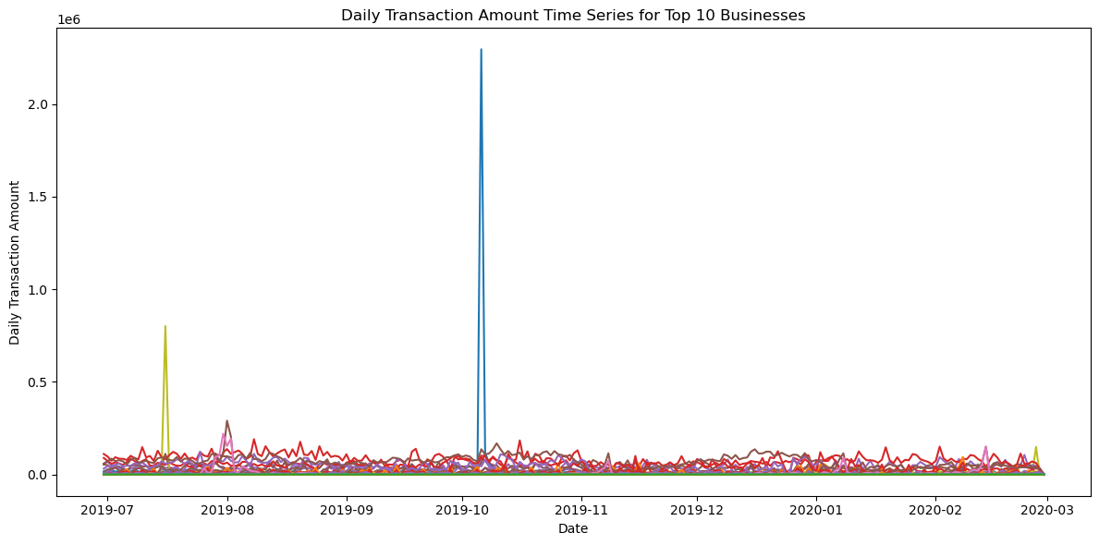
Objective
To identify potential fraudulent or money laundering suspicious cases in the dataset.
Identify businesses which behavior can be considered abnormal.
Identify anomalous transactions within the businesses.
Provide a way of obtaining explanations for the identified anomalous transactions and businesses in a human understandable way.
Anomaly

Slide 3
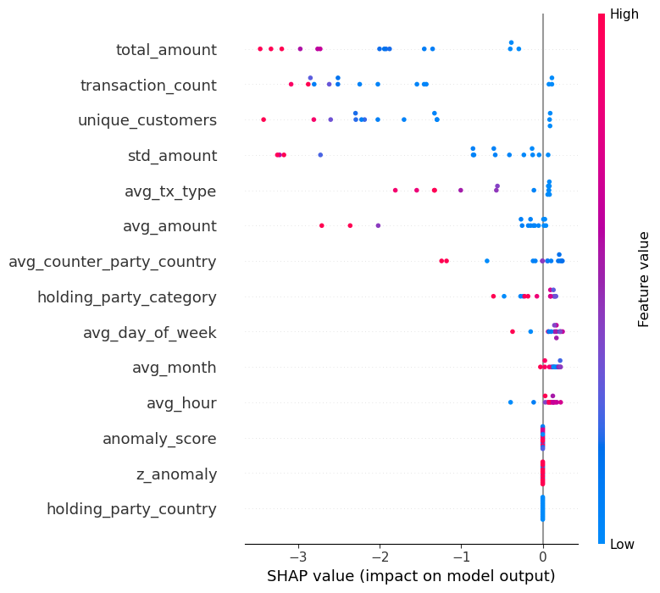
Identify businesses which behavior can be considered abnormal.
From a total of 823 businesses (holding_party_id), approximately 15 businesses (~2%) exhibit anomalous behavior based on our analysis.
For each anomalous business, I have identified the top 3 behavioral factors contributing to their classification as anomalous.
For example, Business ID 365 demonstrates anomalous behavior due to:
High total amount compared to other business
Number of transactions is much higher than typical businesses.
High Number of unique customers .
holding_party_id | Top Reason 1 | Top Reason 2 | Top Reason 3
365 | total_amount | transaction_count | unique_customers
353 | total_amount | transaction_count | unique_customers
364 | unique_customers | transaction_count | total_amount
363 | total_amount | transaction_count | unique_customers
164 | total_amount | transaction_count | unique_customers
165 | total_amount | transaction_count | unique_customers
87 | std_amount | avg_amount | avg_counter_party_country
168 | std_amount | transaction_count | total_amount
315 | total_amount | avg_tx_type | transaction_count
314 | total_amount | avg_tx_type | transaction_count
236 | std_amount | avg_amount | avg_counter_party_country
197 | std_amount | avg_amount | total_amount
361 | transaction_count | total_amount | unique_customers
373 | transaction_count | unique_customers | total_amount
160 | transaction_count | unique_customers | total_amount
Isolation Forest was used to flag businesses with unusual transaction patterns as anomalies.
Each business gets an anomaly score; lower scores mean higher suspicion.
SHAP values are used to identify the top 3 behavioral features causing each business's anomaly.
SHAP analysis reveals the most common features driving anomalies across all businesses.

Slide 4
Identify anomalous transactions within the businesses.
Across 15 businesses, we observe very large total transaction volumes — for example, Business 365 processed over 144,843 transactions, with 0.66% flagged as anomalous.
Although the percentage of anomalous transactions is often below 1%, the absolute number of suspicious activities is significant (e.g., Business 364 had 949 anomalous transactions).
Smaller businesses, like Business 87, show higher anomaly rates (e.g., 16.67% anomalous), suggesting proportionally more risky behavior despite low volume.
Isolation Forest detects suspicious transactions for each anomalous business individually.
Each transaction receives an anomaly score; lower scores indicate more suspicious activity.
Top unusual features (amount, time, type, etc.) are extracted using SHAP values for easy understanding.
Anomalous transactions are sorted by score (most anomalous first) and saved for reviewer prioritization.
holding_party_id | Total Transactions | Anomalous Transactions Detected | Anomalous Transaction %
365 | 144,843 | 963 | 0.66%
364 | 109,967 | 949 | 0.86%
353 | 38,052 | 239 | 0.63%
363 | 34,159 | 327 | 0.96%
165 | 19,492 | 189 | 0.97%
164 | 18,866 | 185 | 0.98%
373 | 10,832 | 68 | 0.63%
160 | 7,364 | 72 | 0.98%
361 | 6,257 | 59 | 0.94%
315 | 5,109 | 49 | 0.96%
314 | 4,933 | 44 | 0.89%
168 | 4,245 | 33 | 0.78%
236 | 30 | 1 | 3.33%
197 | 13 | 1 | 7.69%
87 | 6 | 1 | 16.67%

Slide 5
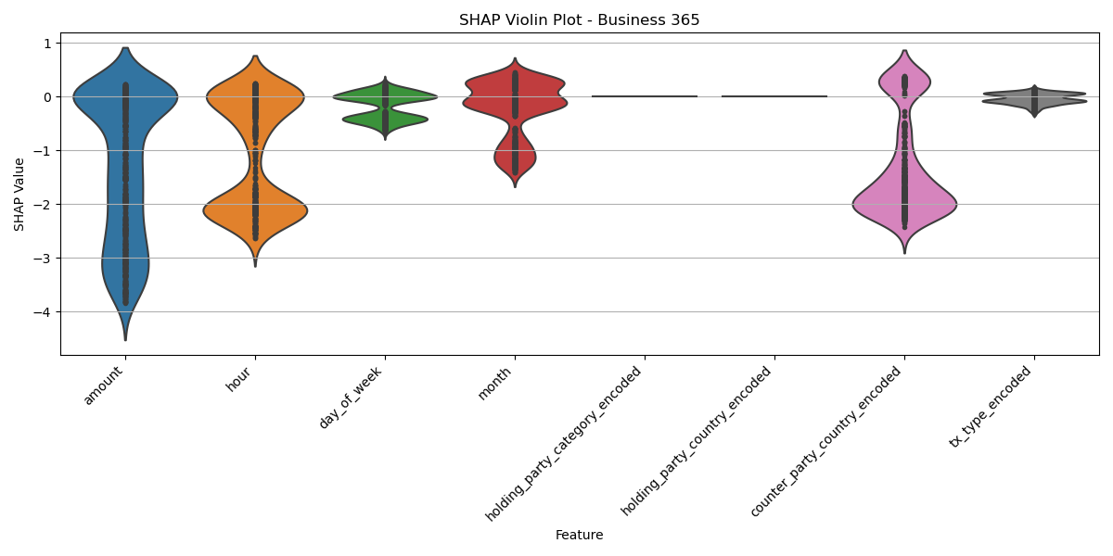
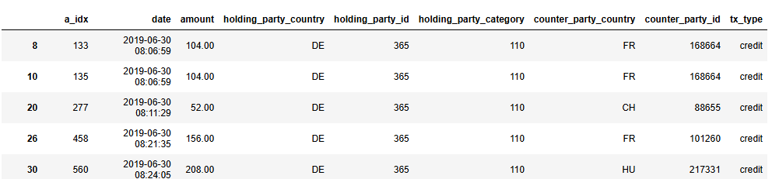
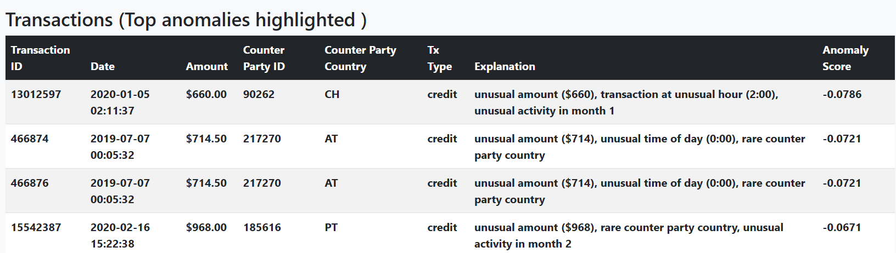
Encoding anomalous transactions human understandable explanations
After finding anomalous transactions within businesses, the top 3 features with the highest absolute SHAP impact are selected as the key anomaly drivers.
Then we convert these top technical features into simple language — e.g., “very high amount ($12,000)” or “transaction at unusual hour (2:00 AM).”
Each anomalous transaction has also given anomalous score so that the human reviewers can prioritize the most anomalous transactions. Then this is is saved along with its human-readable explanation and anomaly score, making auditing and review much easier. A report is created using HTML to see the top reasons for transaction within business followed by transactions list.
Normal Transactions:
Anomalous Transaction with explanation:

Slide 6
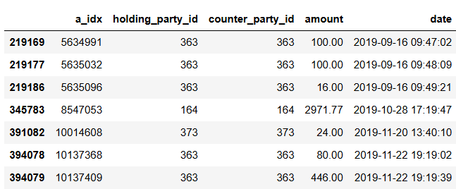
What other things you would do if you had more time and need to dig deeper
Tuning Isolation Forest with the number of trees, number of features to subsample for improved anomaly detection performance
Explore more models using One-Class SVM, Local Outlier Factor (LOF) or deep learning based Autoencoders to achieve good results.
I would also analyze trends over time using moving averages, decomposition, and change point detection to spot recurring fraud cycles that simple models might miss.
If an anomaly was caused due to more than one feature (e.g., high amount and unusual hour together), then can use SHAP interaction values.
Group wise anomaly detection: Cluster business into different groups on the basis of risk profile (Low-risk profile / High-risk profile) and apply a different set of anomaly rules per group before anomaly detection.
For AML - Will create transaction graphs and apply Graph Neural Networks to uncover hidden fraud rings and cyclic transaction behavior. Since we found some cyclic patterns, below shows when both holding and counter party ids were same but we can also find for n-way Cyclic Patterns (A->B and B->A), etc

Slide 7
Analysis of additional reference text of the transaction(if given)
We can prepare the text by eliminating special characters, lowering case form, removal of stopwords (such as the, and), formatting standardization.
we can then perform keyword spotting (e.g., for words like "refund," "cash," "gift," "loan," "investment," etc.) and regular-expression based search for suspicious patterns (e.g., n-number of refunds, cash deposits, etc.)
Then we can convert reference texts into numeric embeddings (TF-IDF or Sentence transformers works), then cluster similar transactions and search for texts that are not matching the usual behavior outlier.
Using models such as Isolation Forest or Autoencoders to run directly on text embeddings to find textual anomalies (i.e., extremely strange citations)
Provide human-readable highlights for flagged suspicious texts – e.g, "Anomaly detected: rare context referring to 'cryptocurrency investment'"

Slide 8
Bonus
An HTML Report has been created in html_reports Folder
After opening index.html file you can navigate to the anomalous business and transaction details.

